Slide 1


Data Spark: Illuminating Insights for Global Electronics

Slide 2


Project Deliverables:
Data Cleaning and Preparation: Ensure all datasets are clean, integrated, and ready for analysis. Exploratory Data Analysis (EDA): Perform EDA to uncover trends, patterns, and insights.
Visualizations: Create visualizations to effectively communicate key findings.
Report: Summarize the analysis and provide actionable recommendations for Global Electronics.
Approach:
Data Cleaning and Preparation
Load Data
Power BI Visualization
Develop 10 SQL Queries.

Slide 3
Datasets Description:
Customers: Demographic and location data.
Sales: Transactional data including order and delivery details. Products: Product attributes such as cost, price, and category. Stores: Store locations, sizes, and operational dates.
Exchange Rates: Historical exchange rate data.
Approach:
Data Cleaning and Preparation
Load Data
Power BI Visualization
Develop 10 SQL Queries.

Slide 4
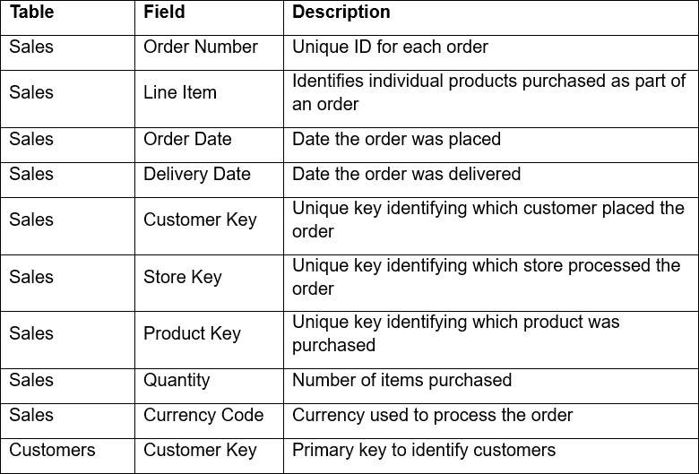
Datasets Description:

Slide 5
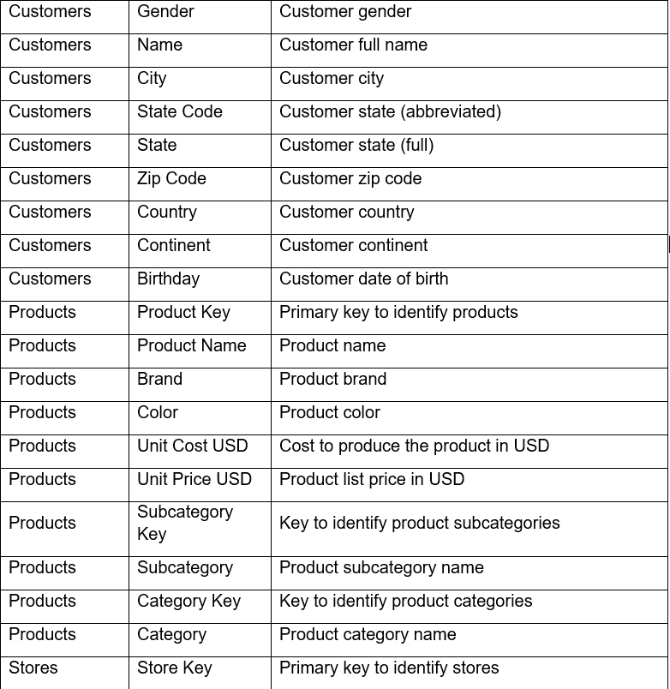
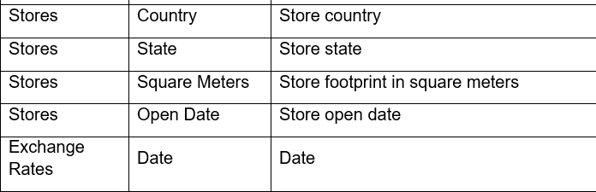
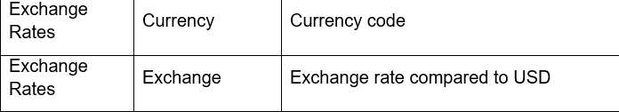

Slide 6


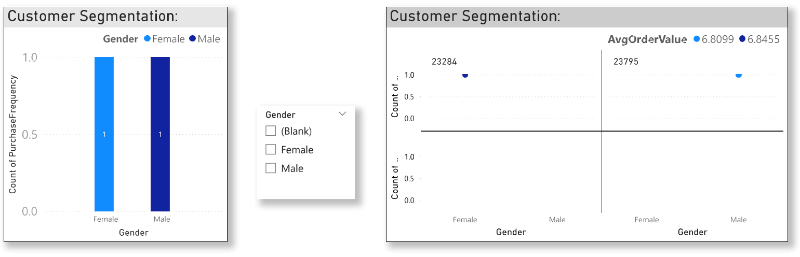
1. Customer Segmentation:
SELECT Gender,avg(Line_Item * Quantity) AS AvgOrderValue,COUNT(Order_Number) AS PurchaseFrequency FROM Sales JOIN customer ON Sales.CustomerKey = Customer.CustomerKey GROUP BY Gender;

Slide 7
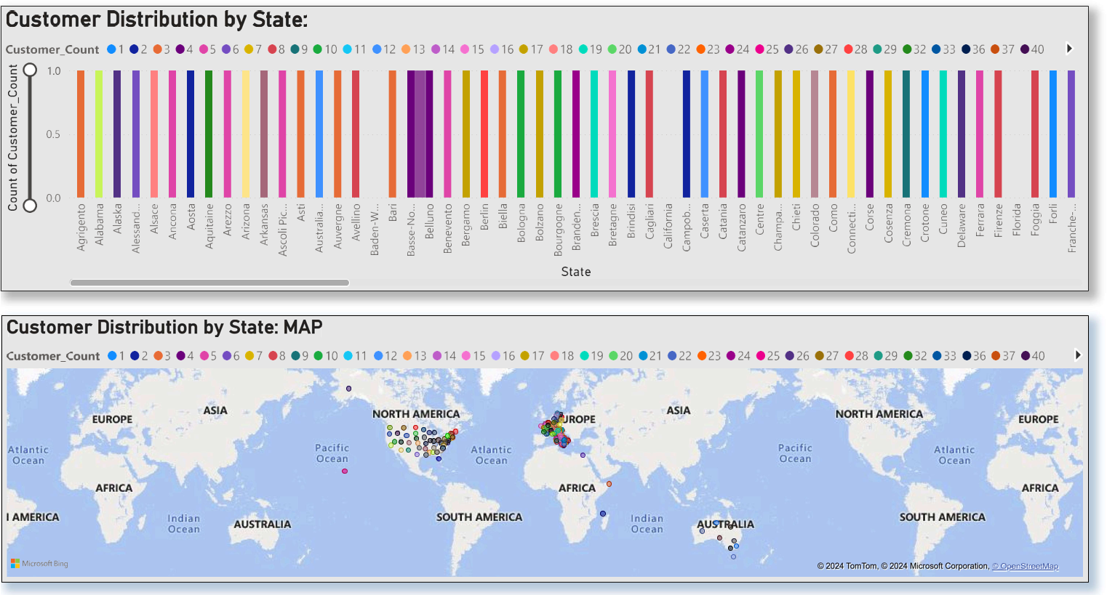
2. Customer Distribution by State::
SELECT c.State, COUNT(DISTINCT c.CustomerKey) AS Customer_Count FROM customer c GROUP BY c.State ORDER BY Customer_Count DESC;

Slide 8
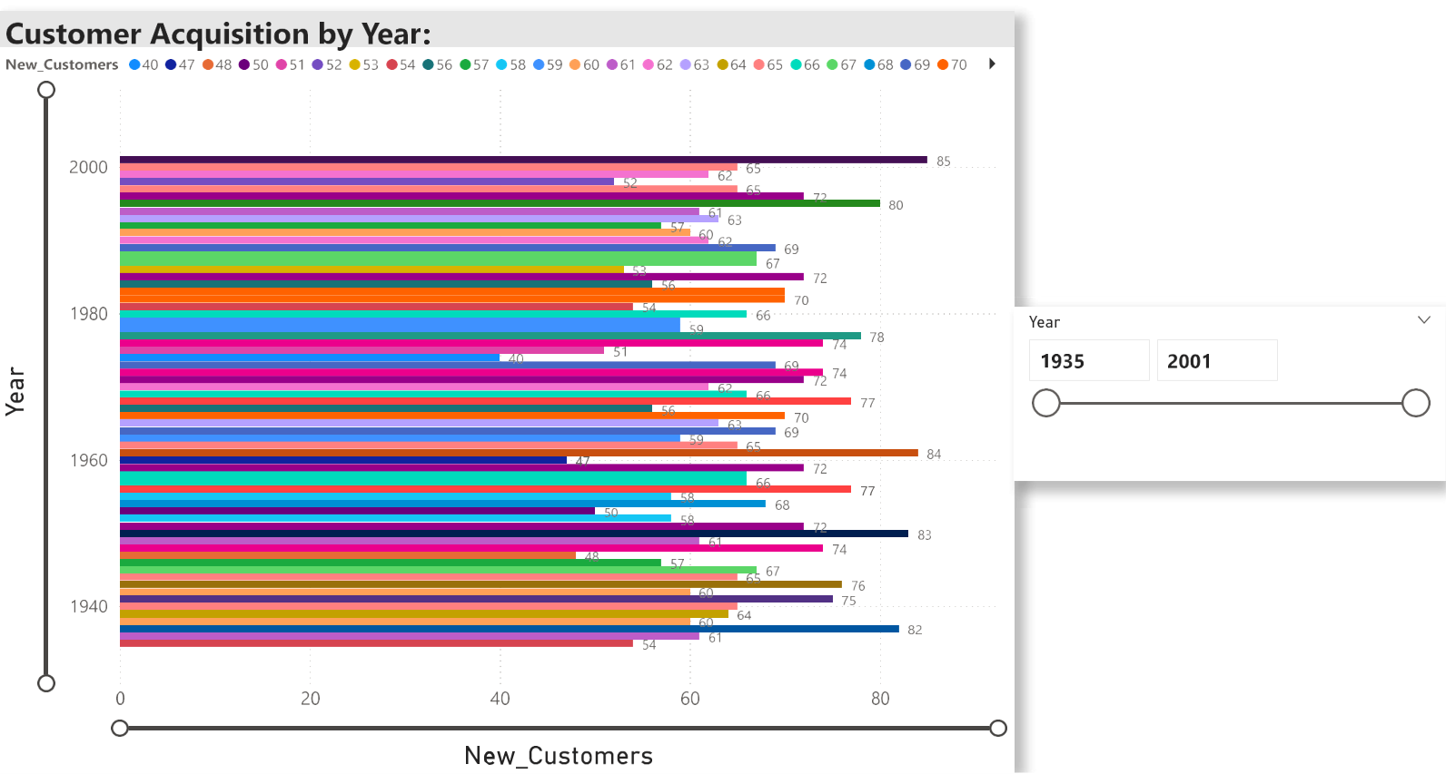
3. Customer Acquisition by Year:
SELECT YEAR(c.Birthday) AS Year, COUNT(DISTINCT c.CustomerKey) AS New_Customers FROM customer c WHERE c.Birthday IS NOT NULL GROUP BY Year ORDER BY Year DESC;

Slide 9

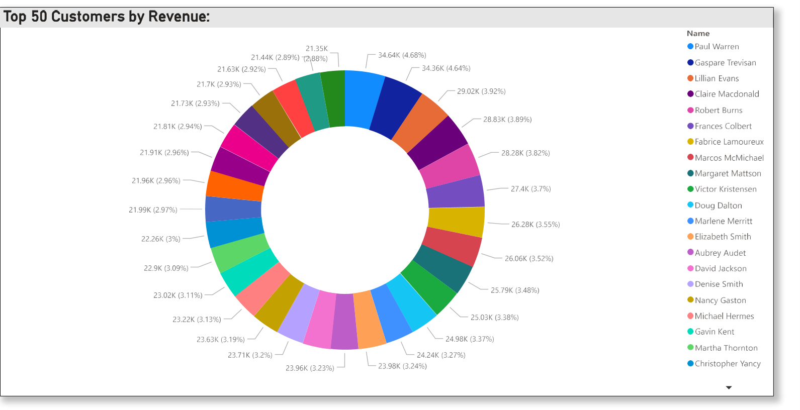
4. Top 50 Customers by Revenue::
SELECT c.Name, SUM(s.Quantity * p.Unit_Price_USD) AS Customer_Revenue FROM sales s JOIN customer c ON s.CustomerKey = c.CustomerKey
JOIN products p ON s.ProductKey = p.ProductKey GROUP BY c.Name ORDER BY Customer_Revenue DESC LIMIT 50;

Slide 10

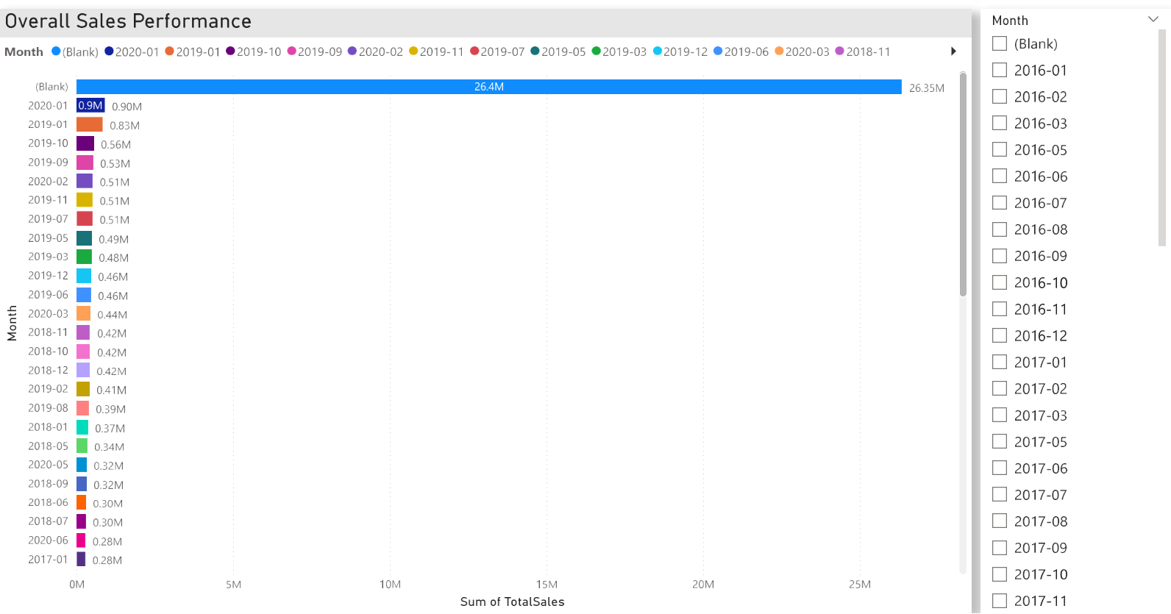
5. Overall Sales Performance:
SELECT DATE_FORMAT(Order_Date, '%Y-%m') AS Month,SUM(Unit_Price_USD * Quantity) AS TotalSales FROM Sales JOIN Products
ON Sales.ProductKey = Products.ProductKey GROUP BY Month ORDER BY Month;

Slide 11
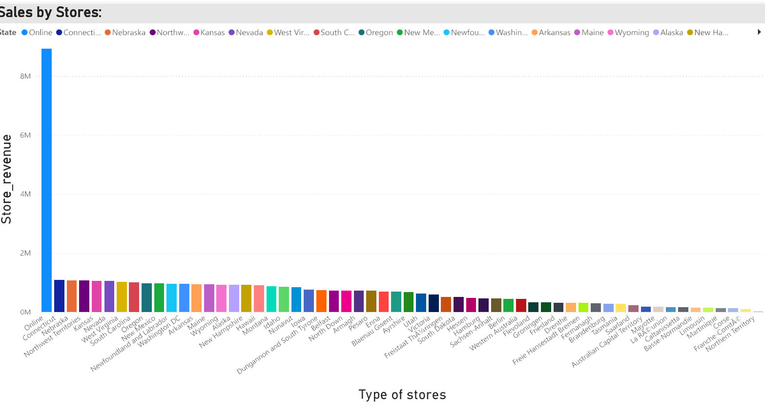
6. Sales by Store:
SELECT st.State, SUM(s.Quantity * p.Unit_Price_USD) AS Store_Revenue FROM sales s
JOIN stores st ON s.StoreKey = st.StoreKey JOIN products p ON s.ProductKey = p.ProductKey GROUP BY st.State ORDER BY Store_Revenue DESC;

Slide 12

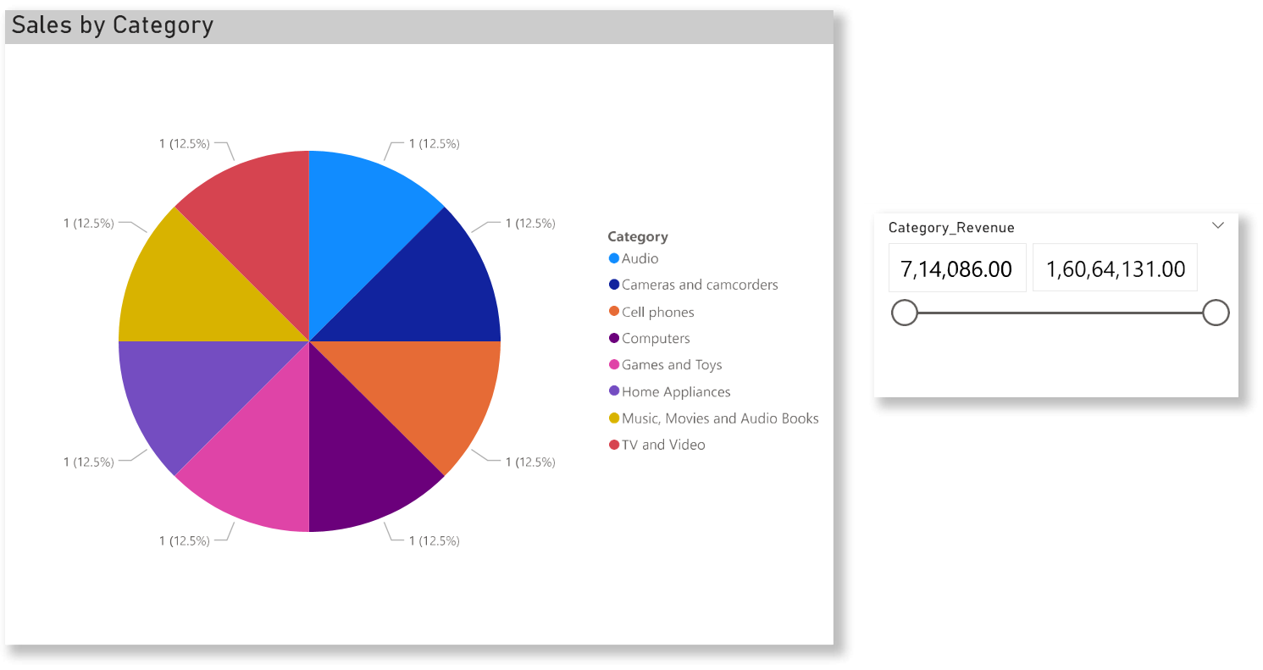
7. Sales by Category:
SELECT p.Category, SUM(s.Quantity * p.Unit_Price_USD) AS Category_Revenue FROM sales s JOIN products p ON s.ProductKey = p.ProductKey
GROUP BY p.Category ORDER BY Category_Revenue DESC;

Slide 13
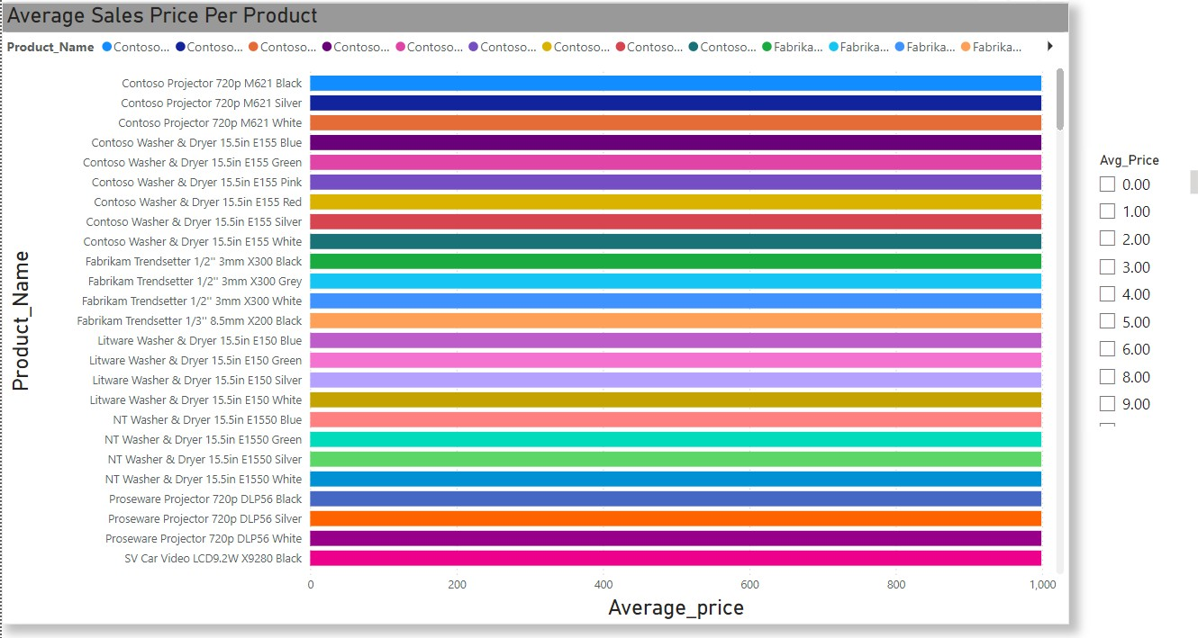
8. Average Sales Price Per Product:
SELECT p.Product_Name, AVG(p.Unit_Price_USD) AS Avg_Price FROM products p GROUP BY p.Product_Name ORDER BY Avg_Price DESC;

Slide 14
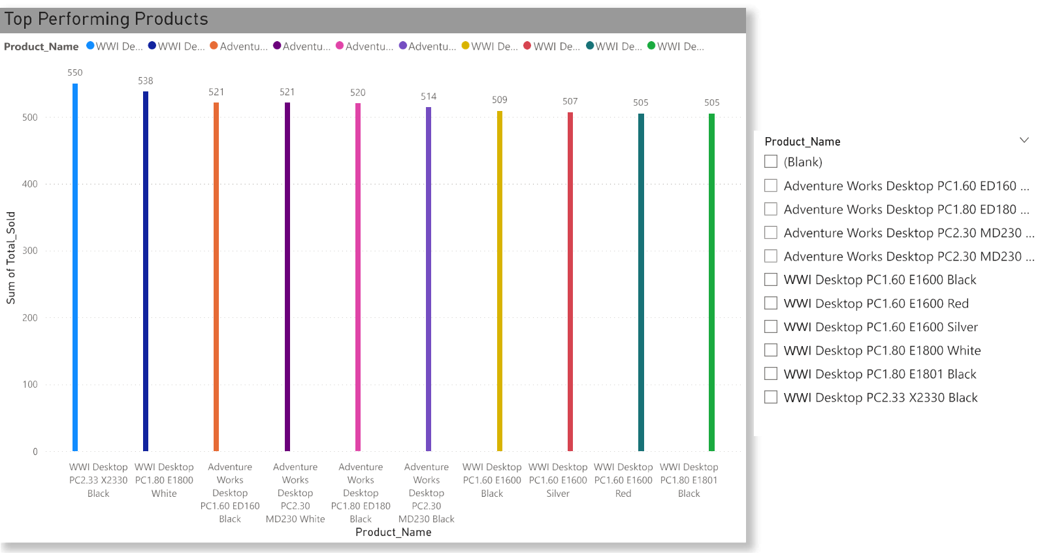
9. Top Performing Products:
SELECT p.Product_Name, SUM(s.Quantity) AS Total_Sold FROM sales s JOIN products p ON s.ProductKey = p.ProductKey GROUP BY p.Product_Name
ORDER BY Total_Sold DESC LIMIT 10;

Slide 15

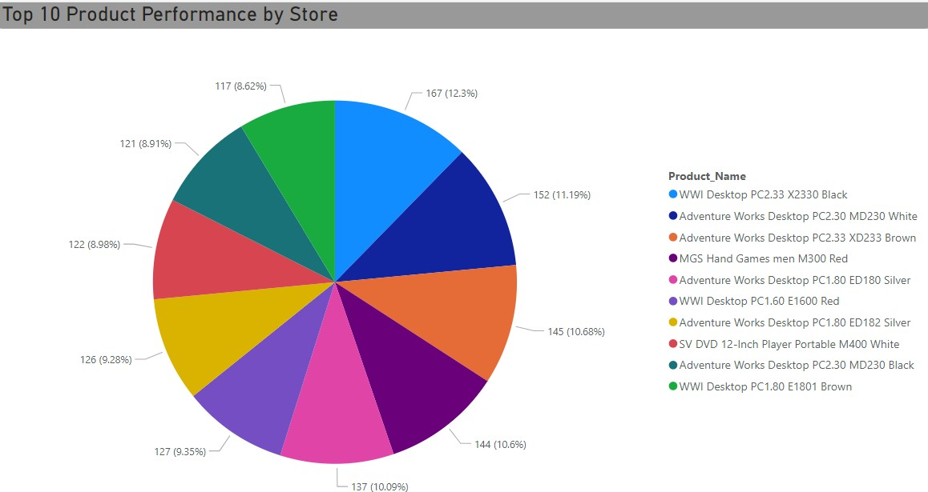
10. Top 10 Product Performance by Store:
SELECT st.State, p.Product_Name, SUM(s.Quantity) AS Total_Sold FROM sales s JOIN stores st ON s.StoreKey = st.StoreKey
JOIN products p ON s.ProductKey = p.ProductKey
GROUP BY st.State, p.Product_Name ORDER BY Total_Sold DESC LIMIT 10;

Slide 16
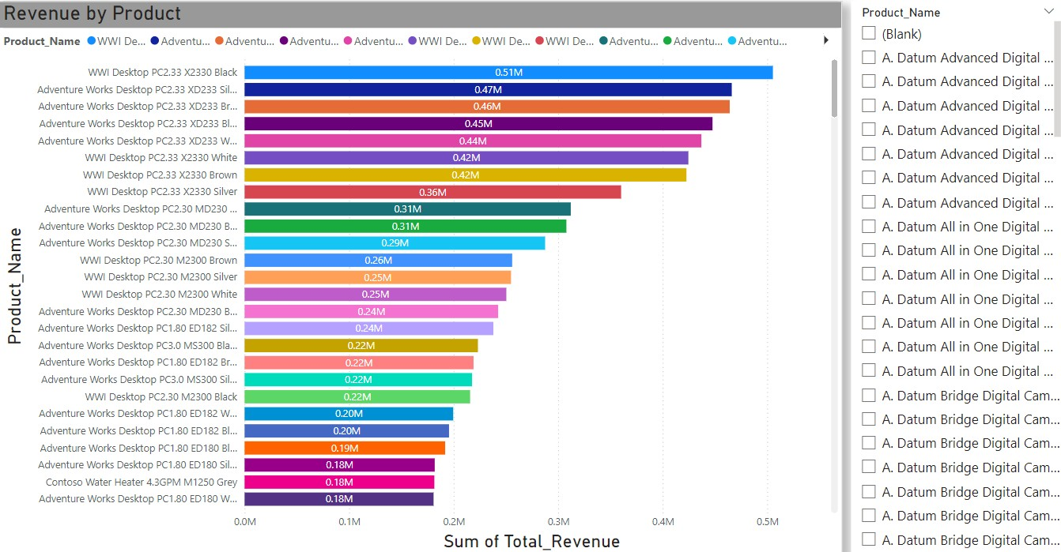
11. Revenue by Product:
SELECT p.Product_Name, SUM(s.Quantity * p.Unit_Price_USD) AS Total_Revenue FROM sales s JOIN products p ON s.ProductKey = p.ProductKey GROUP BY p.Product_Name
ORDER BY Total_Revenue DESC;

Slide 17

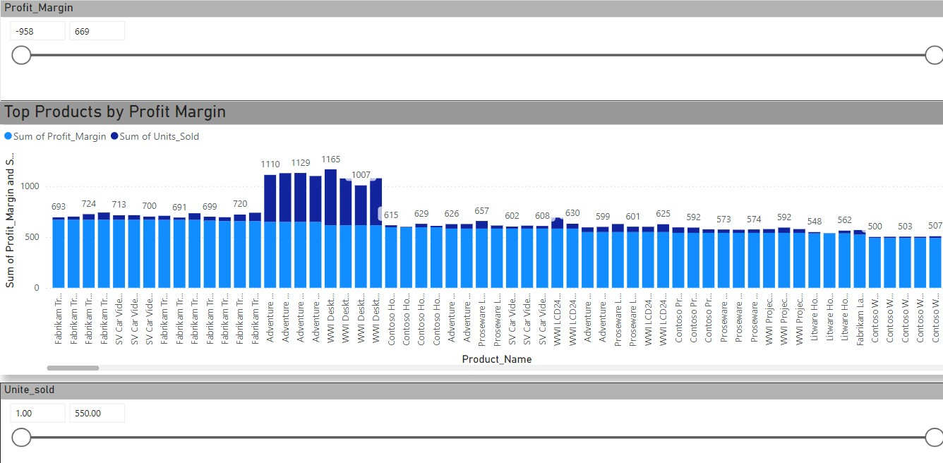
12. Top Products by Profit Margin:
SELECT p.Product_Name, (p.Unit_Price_USD - p.Unit_Cost_USD) AS Profit_Margin, SUM(s.Quantity) AS Units_Sold FROM sales s JOIN products p ON s.ProductKey = p.ProductKey
GROUP BY p.Product_Name, Profit_Margin ORDER BY Profit_Margin DESC, Units_Sold DESC;

